Slide 1
This lecture covers following topics:
What is Socialization:
Importance of Socialization
Types of Socialization
Primary socialization
Secondary socialization
Developmental socialization
Anticipatory socialization
Resocialization
Agents of Socialization
Personality Development and Its Major Theories
Behavioral/psychological Theories
Sociological theories

Slide 2
What is Socialization:
Socialization is defined as a process of learning in life that directly or indirectly influences the actions, beliefs, and behavior of a human being. It encompasses the ideologies and norms of society and results in desirable outcomes and social continuity.
Socialization in simple terms is described as an interaction to establish a balanced relationship between a person and the society he lives in. The process of socialization tells us how to function and work in the community as per the set rules and norms. It tells us to follow the rules, to learn manners, good and bad things, and healthy habits. Remember it is the society as a whole which teaches a person the difference between acceptable and not acceptable so that every individual can live peacefully in it.

Slide 3
Socialization is the learning process wherein we develop our personality through adapting another person`s culture.
Human infants are born without any culture yet. When a baby is born, socialization takes place in order for him to have a culture based on what his parents and his environment would teach him. So what exactly is socialization?
Importance of Socialization
Socialization is an important part of the process of personality formation in every individual. It is true that genetics is the reason behind the structure of human personality, but socialization is the one that causes this personality to be molded to specific directions through the process of accepting or rejecting beliefs, attitudes and societal norms. Because of the dynamics in socialization, we tend to have different personalities although we are living in the same society.

Slide 4
Types of Socialization
Generally, there are five types of socialization: primary, secondary, developmental, anticipatory and resocialization.
Primary socialization This type of socialization happens when a child learns the values, norms and behaviors that should be displayed in order to live accordingly to a specific culture. Example: A child hears his father talk bad words against an old lady. The child would think that this behavior is socially acceptable, so he would start talking bad words against older people.
Secondary socialization This type of socialization occurs when a person learns an appropriate behavior to be displayed within a smaller group which is still part of a larger society. The changes within the values, attitudes and beliefs of an individual are seen to be less important than the changes made in him as he participates in the larger society. Example: A high school graduate chooses a career in Business Management after participating in a small group career seminar led by college business majors

Slide 5
Developmental socialization This type of socialization involves a learning process wherein the focus in on developing our social skills. Example: A shy senior high school student starts to teach English to new freshmen students in order to develop verbal communication.
Anticipatory socialization This type of socialization refers to the process wherein a person practices or rehearses for future social relationships. Example: A child anticipates parenthood as he observes his parents perform their daily roles.
Resocialization This type of socialization involves rejecting previous behavior patterns and accepting new ones so the individual can shift from one part of his life to another. Resocialization is said to be happening throughout human life cycle.

Slide 6
Agents of Socialization
Family
A family serves to reproduce society biologically, through procreation, and socially, through the socialization of children.
LEARNING OBJECTIVES
Analyze the pivotal role a family plays in the socialization of children and the continuation of society through procreation
Key Points
Although a family can fulfill a variety of other functions, not all of these are universal or obligatory.
The incest taboo, which prohibits sexual relations between family members, is a form of exogamy and may help promote social solidarity.
The family of orientation refers to the role of the family in providing children with a position in society and socialize them.
From the parents’ perspective, the family of procreation refers to the family’s role is to produce and socialize children.
Exogamy is a social arrangement according to which marriages can only occur with members outside of one’s social group.

Slide 7
Peer Groups
A peer group, whose members have interests, social positions, and age in common, have an influence on the socialization of group members.
LEARNING OBJECTIVES
Analyze the importance of the peer group in terms of childhood and adolescent socialization
KEY TAKEAWAYS
Key Points
This is where children can escape supervision and learn to form relationships on their own.
The influence of the peer group typically peaks during adolescence.
However, peer groups generally only affect short term interests unlike the family, which has long term influence.
Peer groups can also serve as a venue for teaching members gender roles.
Adolescent peer groups provide support for children and teens as they assimilate into the adult society decreasing dependence on parents, increasing feeling of self-sufficiency, and connecting with a much larger social network.
The term “ peer pressure ” is often used to describe instances where an individual feels indirectly pressured into changing their behavior to match that of their peers

Slide 8
School
Education is the process by which society transmits its accumulated knowledge, skills, customs and values from one generation to another.
LEARNING OBJECTIVES
Explain the role of both formal and informal education in the socialization process, such as learning norms and expectations, as well as gaining social equality
KEY TAKEAWAYS
Key Points
The sociology of education is the study of how public institutions and individual experiences affect education and its outcomes.
A systematic sociology of education began with Émile Durkheim’s work on moral education as a basis for organic solidarity.
Socialization is the process by which the new generation learns the knowledge, attitudes and values that they will need as productive citizens.
The hidden curriculum is a subtler, but nonetheless powerful, indoctrination of the norms and values of the wider society.

Slide 9
Mass Media and Technology
Since mass media has enormous effects on our attitudes and behavior, it contributes to the socialization process.
LEARNING OBJECTIVES
Analyze the connection between media, technology and society
KEY TAKEAWAYS
Key Points
Mass media is the means for delivering impersonal communications directed to a vast audience.
The term media comes from Latin meaning, “middle,” suggesting that the media’s function is to connect people.
Media bias refers to the bias of journalists and news producers within mass media. Bias exists in the selection of events and stories that are reported and how they are covered.
A technique used to avoid bias is the “round table,” an adversarial format in which representatives of opposing views comment on an issue.
A technique used to avoid bias is the “round table”, an adversarial format in which representatives of opposing views comment on an issue.

Slide 10
Neighborhood
A neighborhood is a geographically localized community within a larger city, town, or suburb.
LEARNING OBJECTIVES
Justify the importance of neighborhoods and communities as units of socialization, especially when specialized, such as by ethnicity or religion
KEY TAKEAWAYS
Key Points
Ethnic neighborhoods were important in many historical cities, and they remain common in modern cities.
Rural-to-urban migration contributed to neighborhood distinctiveness and social cohesion in historical cities.
A community is a group of interacting people, living in some proximity. Community usually refers to a social unit—larger than a household—that shares common values and has social cohesion.
Social capital refers to a sense of connectedness due to the formation of social networks in a given community.

Slide 11
Religion
Religion is a collection of cultural systems, belief systems, and worldviews that relate humanity to spirituality and moral values.
LEARNING OBJECTIVES
Explain how people come to be socialized in terms of religion and how parental influence is a key factor in religiosity
KEY TAKEAWAYS
Key Points
Sociology of religion is the study of the beliefs, practices, and organizational forms of religion using the tools and methods of the discipline of sociology.
Agents of socialization differ in effects across religious traditions. Some believe religion is like an ethnic or cultural category, making it less likely for the individuals to break from religious affiliations and be more socialized in this setting.
Belief in God is attributable to a combination of the above factors, but is also informed by a discussion of socialization. The biggest predictor of adult religiosity is parental religiosity; if a person’s parents were religious when he was a child, he is likely to be religious when he grows up.
In their thesis, Altemeyer and Hunsberger found some interesting cases where secular people converted to religion, and religious people became secular.

Slide 12
Personality Development and Its Major Theories
What exactly is personality? Where does it come from? Does it change as we grow older? These are the sorts of questions that have long held the fascination of psychologists and which have inspired a number of different theories of personality.
Defining Personality
While personality is something that we talk about all the time ("He has such a great personality!" or "Her personality is perfect for this job!"), you might be surprised to learn that psychologists do not necessarily agree on a single definition of what exactly constitutes personality.
Personality is broadly described as the characteristic patterns of thoughts, feelings, and behaviors that make a person unique. In plain English, it is what makes you.

Slide 13
Characteristics of Personality
In order to understand the psychology of personality, it is important to learn some of the key characteristics of how personality works.¹﻿
Personality is organized and consistent.
We tend to express certain aspects of our personality in different situations and our responses are generally stable.
Although personality is generally stable, it can be influenced by the environment.
For example, while your personality might lead you to be shy in social situations, an emergency might lead you to take on a more outspoken and take-charge approach.
Personality causes behaviors to happen.
You react to the people and objects in your environment based on your personality. From your personal preferences to your choice of a career, every aspect of your life is affected by your personality.

Slide 14

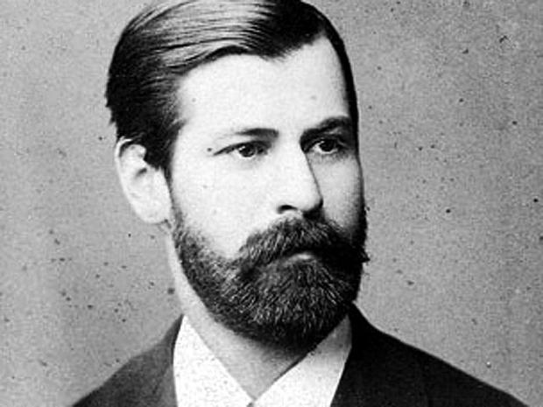
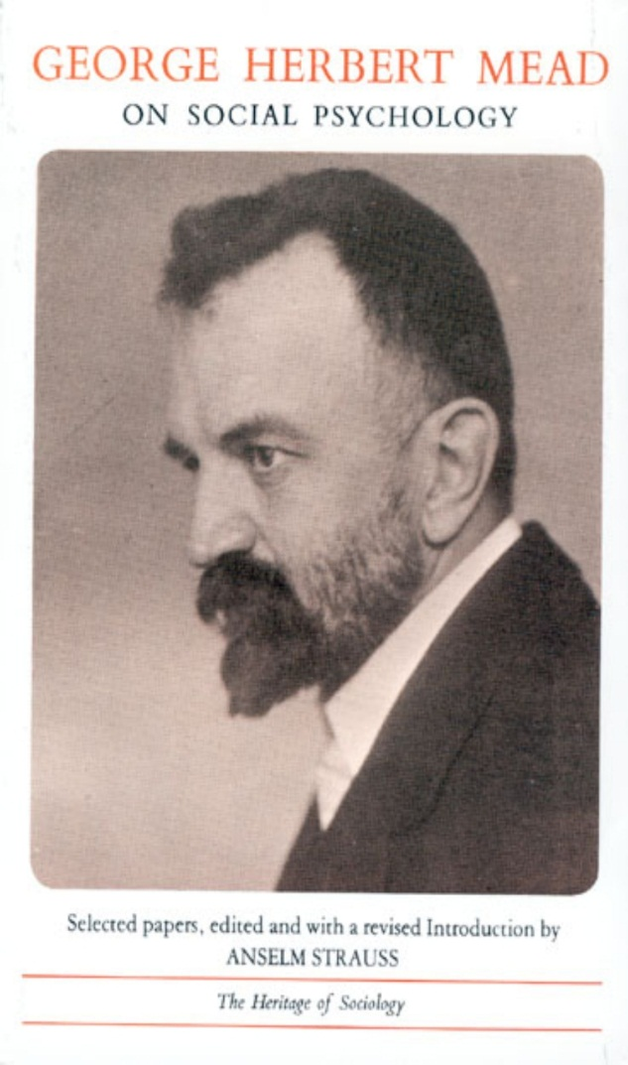
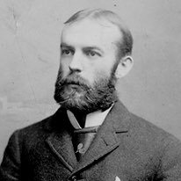
A vast variety of people have contributed to the theory of primary socialization, of those including Sigmund Freud, George Herbert Mead, Charles Cooley, Jean Piaget and Talcott Parsons. However, Parson's theories are the earliest and most significant contributions to socialization and cognitive development.

Slide 15
Major Theories
Personality psychology is the focus of some of the best-known psychology theories by a number of famous thinkers including Sigmund Freud and Erik Erikson. Some of these theories attempt to tackle a specific area of personality while others attempt to explain personality much more broadly.
Biological Theories
Biological approaches suggest that genetics are responsible for personality. In the classic nature versus nurture debate, the biological theories of personality side with nature.
Research on heritability suggests that there is a link between genetics and personality traits.³﻿ Twin studies are often used to investigate which traits might be linked to genetics versus those that might be linked to environmental variables. For example, researchers might look at differences and similarities in the personalities of twins reared together versus those who are raised apart.

Slide 16
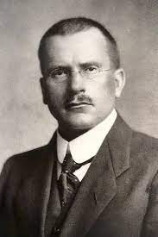
Carl Jung,
Sigmund Freud
Below are the most prominent psychoanalytic perspective theorists:
Sigmund Freud: Stressed the importance of early childhood events, the influence of the unconscious, and sexual instincts in the development and formation of personality.
Erik Erikson: Emphasized the social elements of personality development, the identity crisis, and how personality is shaped over the course of the entire lifespan.

Slide 17
Behavioral Theories
Behavioral theorists include B. F. Skinner and John B. Watson. Behavioral theories suggest that personality is a result of interaction between the individual and the environment.⁵﻿ Behavioral theorists study observable and measurable behaviors, rejecting theories that take internal thoughts, moods, and feelings play a part as these cannot be measured.
According to behavioral theorists, conditioning (predictable behavioral responses) occurs through interactions with our environment which ultimately shapes our personalities.
Freud suggested that children progress through a series of stages in which the id's energy is focused on different erogenous zones.

Slide 18
Id
According to Freud’s psychoanalytic theory of personality, the id is the personality component made up of unconscious psychic energy that works to satisfy basic urges, needs, and desires. The id operates based on the pleasure principle, which demands immediate gratification of needs.
Ego
According to Freud, the ego is the largely unconscious part of the personality that mediates the demands of the id, the superego, and reality. The ego prevents us from acting on our basic urges (created by the id) but also works to achieve a balance with our moral and idealistic standards (created by the superego).
Superego
The superego is the component of personality composed of our internalized ideals that we have acquired from our parents and from society. The superego works to suppress the urges of the id and tries to make the ego behave morally, rather than realistically.

Slide 19
Theories of Self-Development under sociology perspective:
LEARNING OBJECTIVES
By the end of this section, you will be able to:
Understand the difference between psychological and sociological theories of self-development
Explain the process of moral development.
When we are born, we have a genetic makeup and biological traits. However, who we are as human beings develops through social interaction. Many scholars, both in the fields of psychology and in sociology, have described the process of self-development as a precursor to understanding how that “self” becomes socialized.
SOCIOLOGY OR PSYCHOLOGY: WHAT’S THE DIFFERENCE?
You might be wondering: if sociologists and psychologists are both interested in people and their behavior, how are these two disciplines different? What do they agree on, and where do their ideas diverge? The answers are complicated, but the distinction is important to scholars in both fields.

Slide 20
As a general difference
we might say that while both disciplines are interested in human behavior, psychologists are focused on how the mind influences that behavior, while sociologists study the role of society in shaping behavior. Psychologists are interested in people’s mental development and how their minds process their world. Sociologists are more likely to focus on how different aspects of society contribute to an individual’s relationship with his world. Another way to think of the difference is that psychologists tend to look inward (mental health, emotional processes), while sociologists tend to look outward (social institutions, cultural norms, interactions with others) to understand human behavior.

Slide 21
Sociological Theories of Self-Development
One of the pioneering contributors to sociological perspectives was Charles Cooley (1864–1929). He asserted that people’s self understanding is constructed, in part, by their perception of how others view them—a process termed “the looking glass self” (Cooley, 1902).
Later, George Herbert Mead (1863–1931) studied the self, a person’s distinct identity that is developed through social interaction. In order to engage in this process of “self,” an individual has to be able to view him or herself through the eyes of others. That’s not an ability that we are born with (Mead, 1934). Through socialization we learn to put ourselves in someone else’s shoes and look at the world through their perspective. This assists us in becoming self-aware, as we look at ourselves from the perspective of the “other.”

Slide 22
Kohlberg’s Theory of Moral Development
Moral development is an important part of the socialization process. The term refers to the way people learn what society considered to be “good” and “bad,” which is important for a smoothly functioning society. Moral development prevents people from acting on unchecked urges, instead considering what is right for society and good for others. Lawrence Kohlberg (1927–1987) was interested in how people learn to decide what is right and what is wrong. To understand this topic, he developed a theory of moral development that includes three levels: preconvention, conventional, and post conventional.

Slide 23
Gilligan’s Theory of Moral Development and Gender
Another sociologist, Carol Gilligan (1936–), recognized that Kohlberg’s theory might show gender bias since his research was only conducted on male subjects. Would females study subjects have responded differently? Would a female social scientist notice different patterns when analyzing the research? To answer the first question, she set out to study differences between how boys and girls developed morality. Gilligan’s research demonstrated that boys and girls do, in fact, have different understandings of morality. Boys tend to have a justice perspective, by placing emphasis on rules and laws. Girls, on the other hand, have a care and responsibility perspective; they consider people’s reasons behind behavior that seems morally wrong.

Slide 24
Concluding Remarks of today’s lecture:
Psychological theories of self-development have been broadened by sociologists who explicitly study the role of society and social interaction in self-development. Charles Cooley and George Mead both contributed significantly to the sociological understanding of the development of self. Lawrence Kohlberg and Carol Gilligan developed their ideas further and researched how our sense of morality develops. Gilligan added the dimension of gender differences to Kohlberg’s theory.

